Slide 1
Analysis of AI labor market and skills demand
BIA-660 Project Presentation
Huayi Xu, Tianyi Li
2021/12/06

Slide 2
1
Introduction
2
Data Collection
3
Data Preprocessing
CONTENTS
4
Topic Analysis
5
Model
6
Future work

Slide 3
01
Introduction

Slide 4

Introduction
Background:
Intelligent technology is gradually replacing different kinds of work in life, which greatly liberates productivity. But on the other hand, we have higher demands for people's professional skills
What did we do?
Through the information on job website, we could analyze the current trends and development prospects of these most cutting-edge application technologies. This can not only help people understand the current commercial applications of AI in various fields, but also provide more information such as skill requirements and salary prospects for people who want to work in these fields.

Slide 5
Introduction
Preliminary Literature Review:
Previous studies use a lot of long-term data to illustrate the increase and decrease of jobs under the influence of AI, as well as the comparison of the salaries of AI workers with salaries in other industries.
Limitations:
However, in these studies, we have not seen specific skill requirements and trends in AI field. It also does not compare the correlation between factors such as regions, skills and salary. Similarly, these reports did not give the latest specific values of some factors that workers are concerned about (such as salary). Therefore, there is a lack of practical guidance information for AI professionals.
In our report, we will focus on these neglected issues in other studies. We obtain and analyze the most direct demand analysis for workers in the AI field from the recruitment needs of the labor market website.

Slide 6
Introduction
Research Question:
1. In AI field, what skills (soft skills or technical skills) are highly need? Can we give a reasonable career planning guidance?
2. According to factors such as skill requirements, company locations, etc., can we build a salary level prediction model?
We expect this work can make the following contributions:
1. This search can provide practical guidance information such as specific skill requirements and trends in each AI domain for professionals.
2. We provide a machine learning model that can predict salary level in AI domain based on factors such as workers’ experience, skills, company location, etc.

Slide 7
02
Data Collection

Slide 8
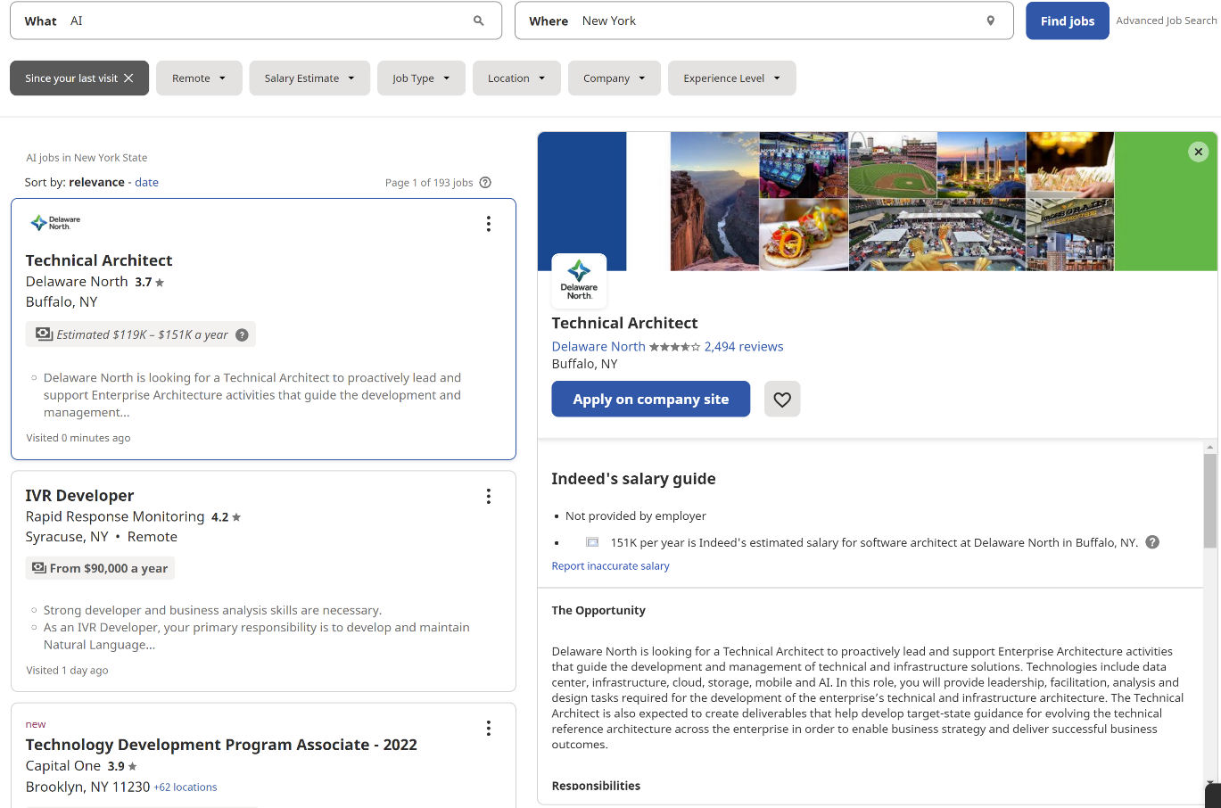
Data Collection
Data scraping
Data source: www.indeed.com.
Indeed is an American worldwide employment website for job listings. One of highest-traffic job websites.

Slide 9
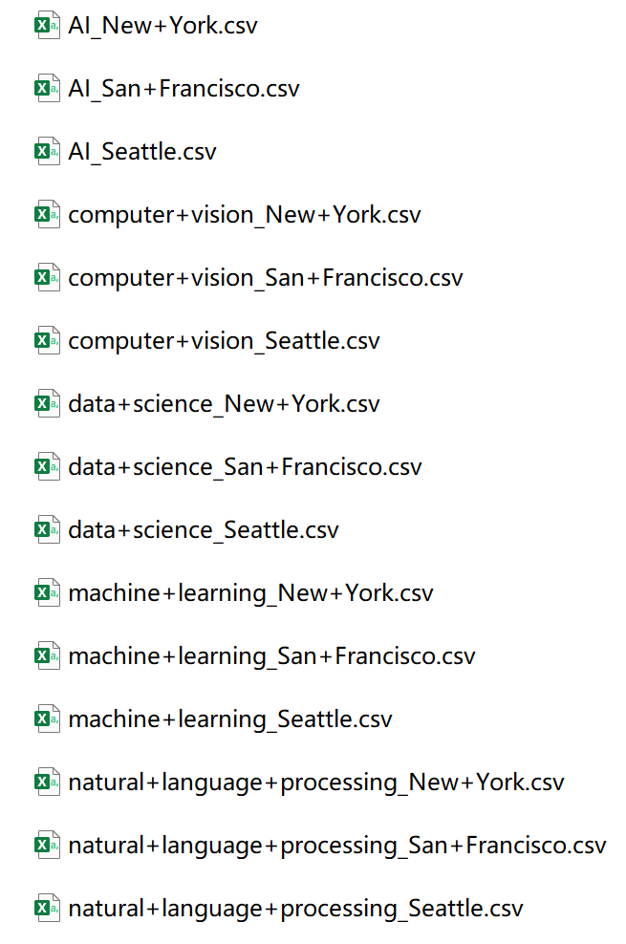
Data Collection
Data scraping
Using Selenium and Request, we scrape information in five fields which posted in three regions:
5 fields : AI, computer vision, natural language processing, data science and machine learning.
3 regions: New York City, Seattle and San Francisco.
In each field and region, we crawl the first 50 pages of data.

Slide 10
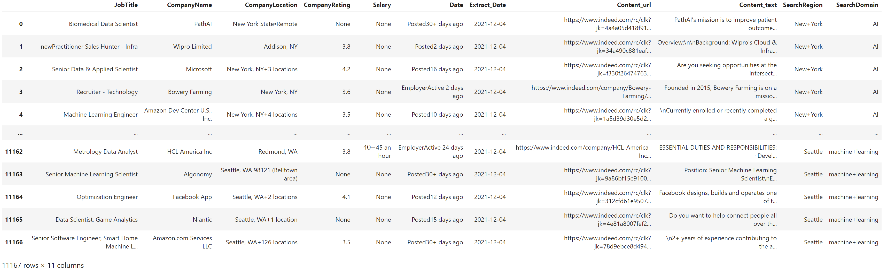
Data Collection
Data analysis
The dataset has 11167 rows and 11 columns:
Job Title, Company Name, Company Location, Company Rating, Salary, Extracted Date, Publish Date, Content URL, Content text , SearchRegion , SearchDomain

Slide 11
03
Data Preprocessing

Slide 12
Data Preprocessing
Observe the distribution and delete those empty and None rows.
Uniform the scale, such like Data and Salary. We turn the string type salary into an integer value.
Do one-hot encoding on these columns, such as Job type and Company Location.
Based on the job title, extract whether it is a senior position and calculate the tf-idf of the job title.
Based on the job description, generate the description keywords. Then, we extract some feature from these keywords, such as degree and skills requirements.
Based on the hot map and experimental results on validation set, we can get the final feature.

Slide 13
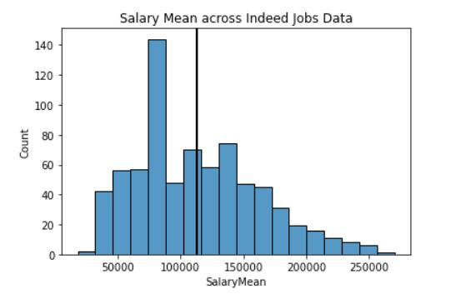
Data Preprocessing
Salary

Slide 14
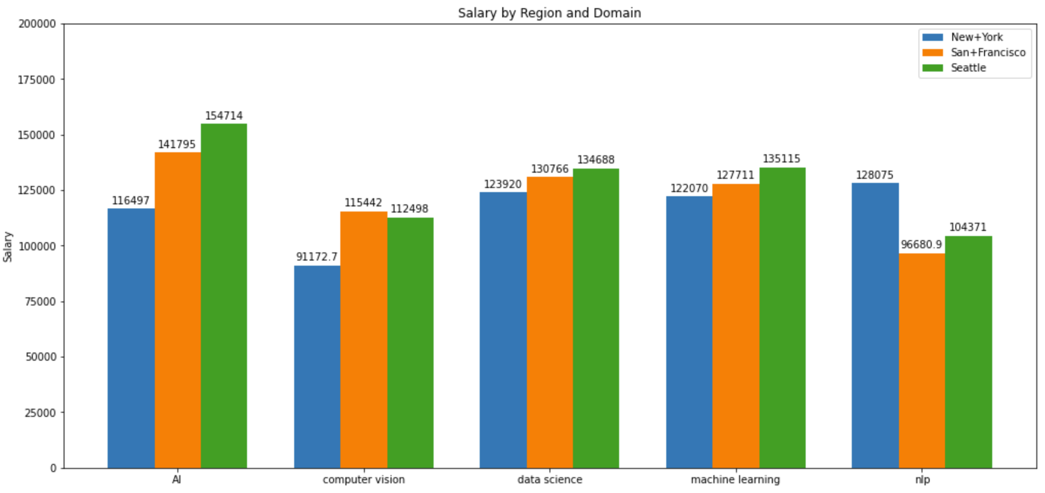
Data Preprocessing
Salary by region and domain

Slide 15
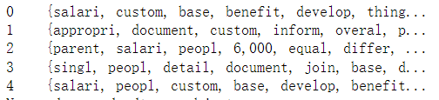
Data Preprocessing
Description Words
Word tokenization
Remove punctuation and stopwords
Filter it by pos-tag
Get the description words of the job:

Slide 16
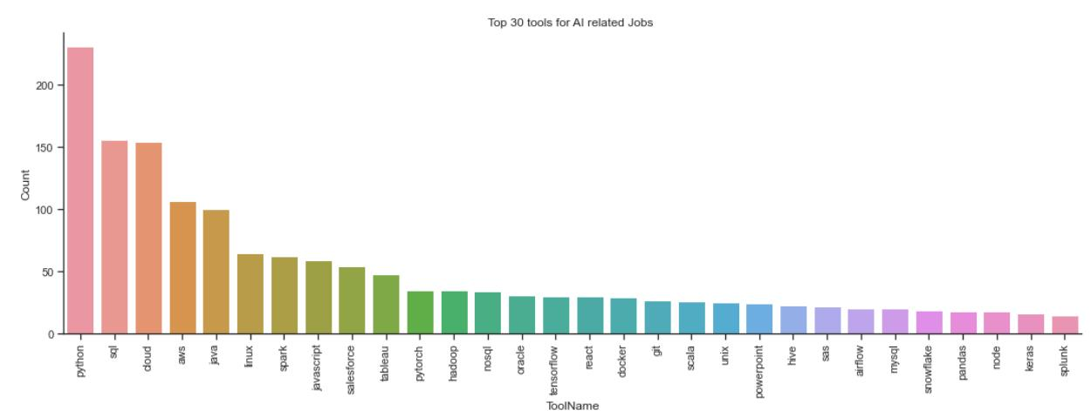
Data Preprocessing
Top 30 tools for AI related jobs

Slide 17
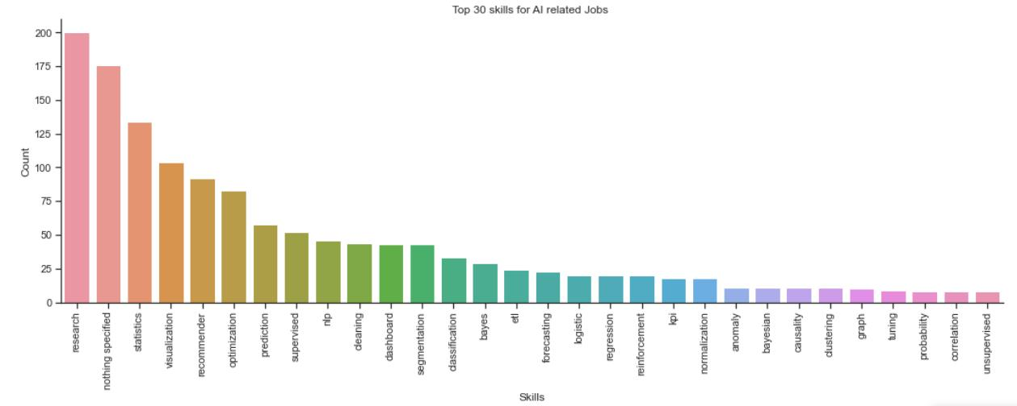
Data Preprocessing
Top 30 skills for AI related jobs

Slide 18
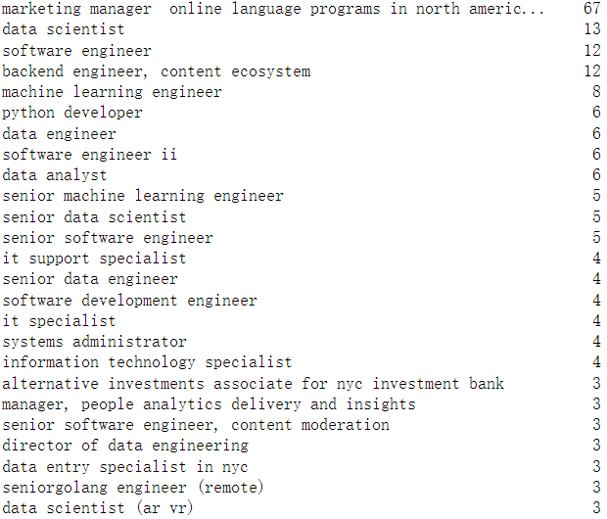
Data Preprocessing
Job title

Slide 19
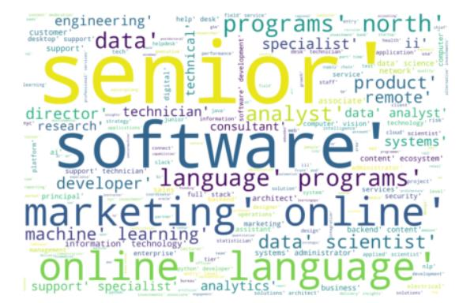
Data Preprocessing
Word cloud of job title

Slide 20
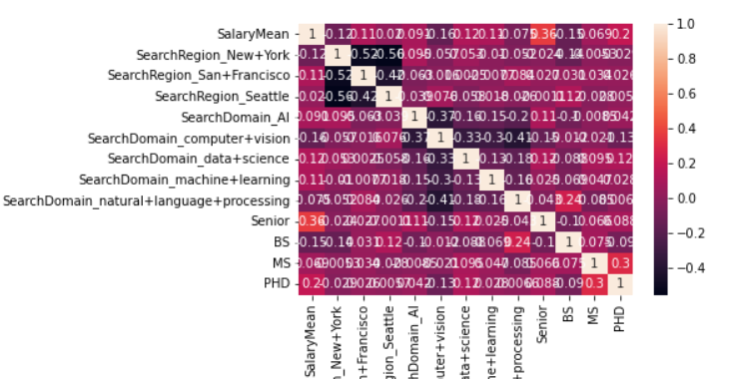
Data Preprocessing
Hot map of the correlation

Slide 21
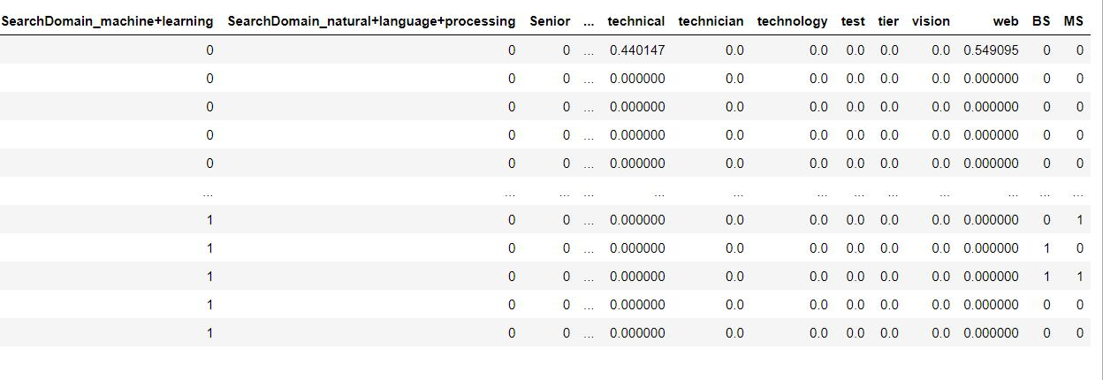
Data Preprocessing
Final Feature

Slide 22
04
Topic Analysis

Slide 23
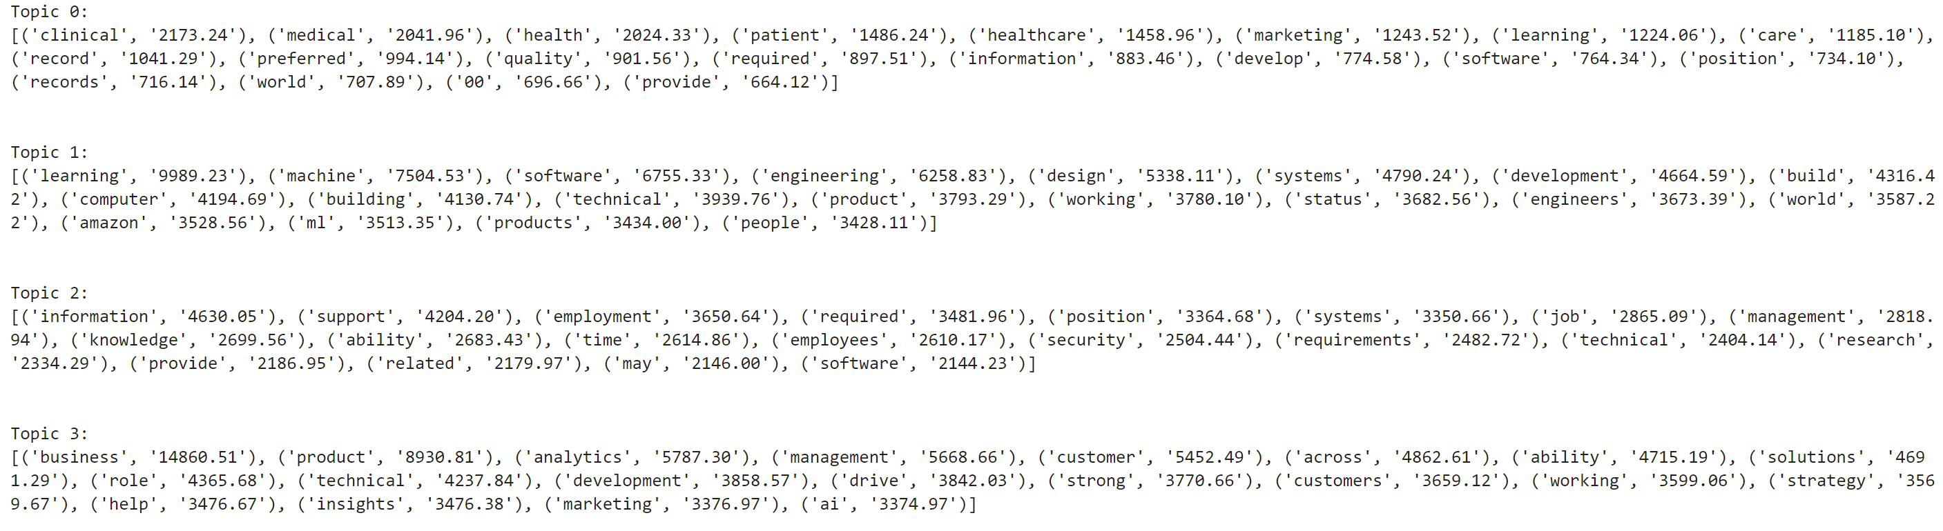
Topic Analysis
Where does it work?
1. Discovering potential information
2. Using these hidden information as a feature for the later prediction model
Choosing 4 topics:

Slide 24
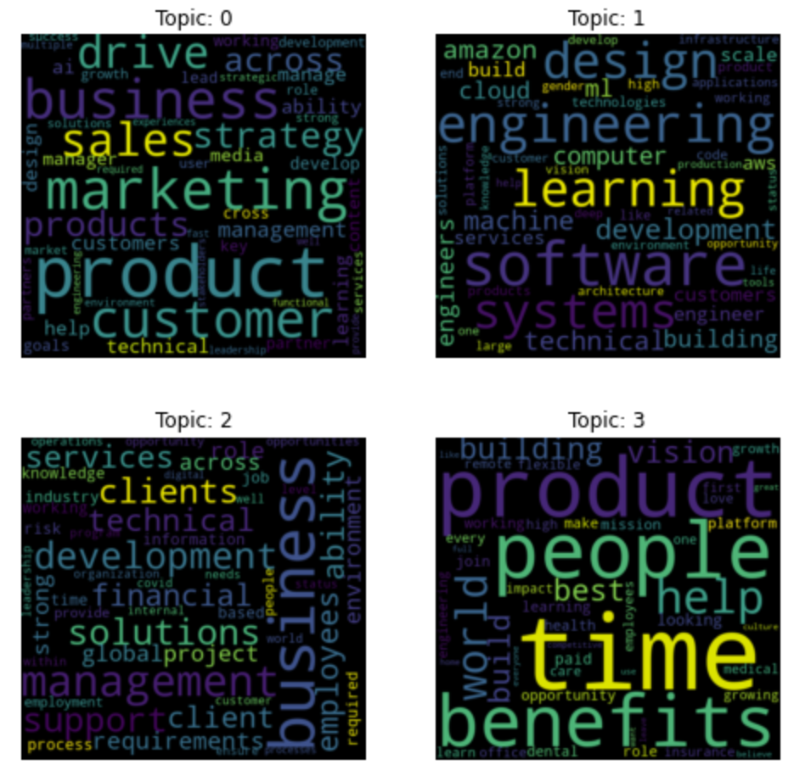
Topic Analysis
Word cloud for 4 topics

Slide 25
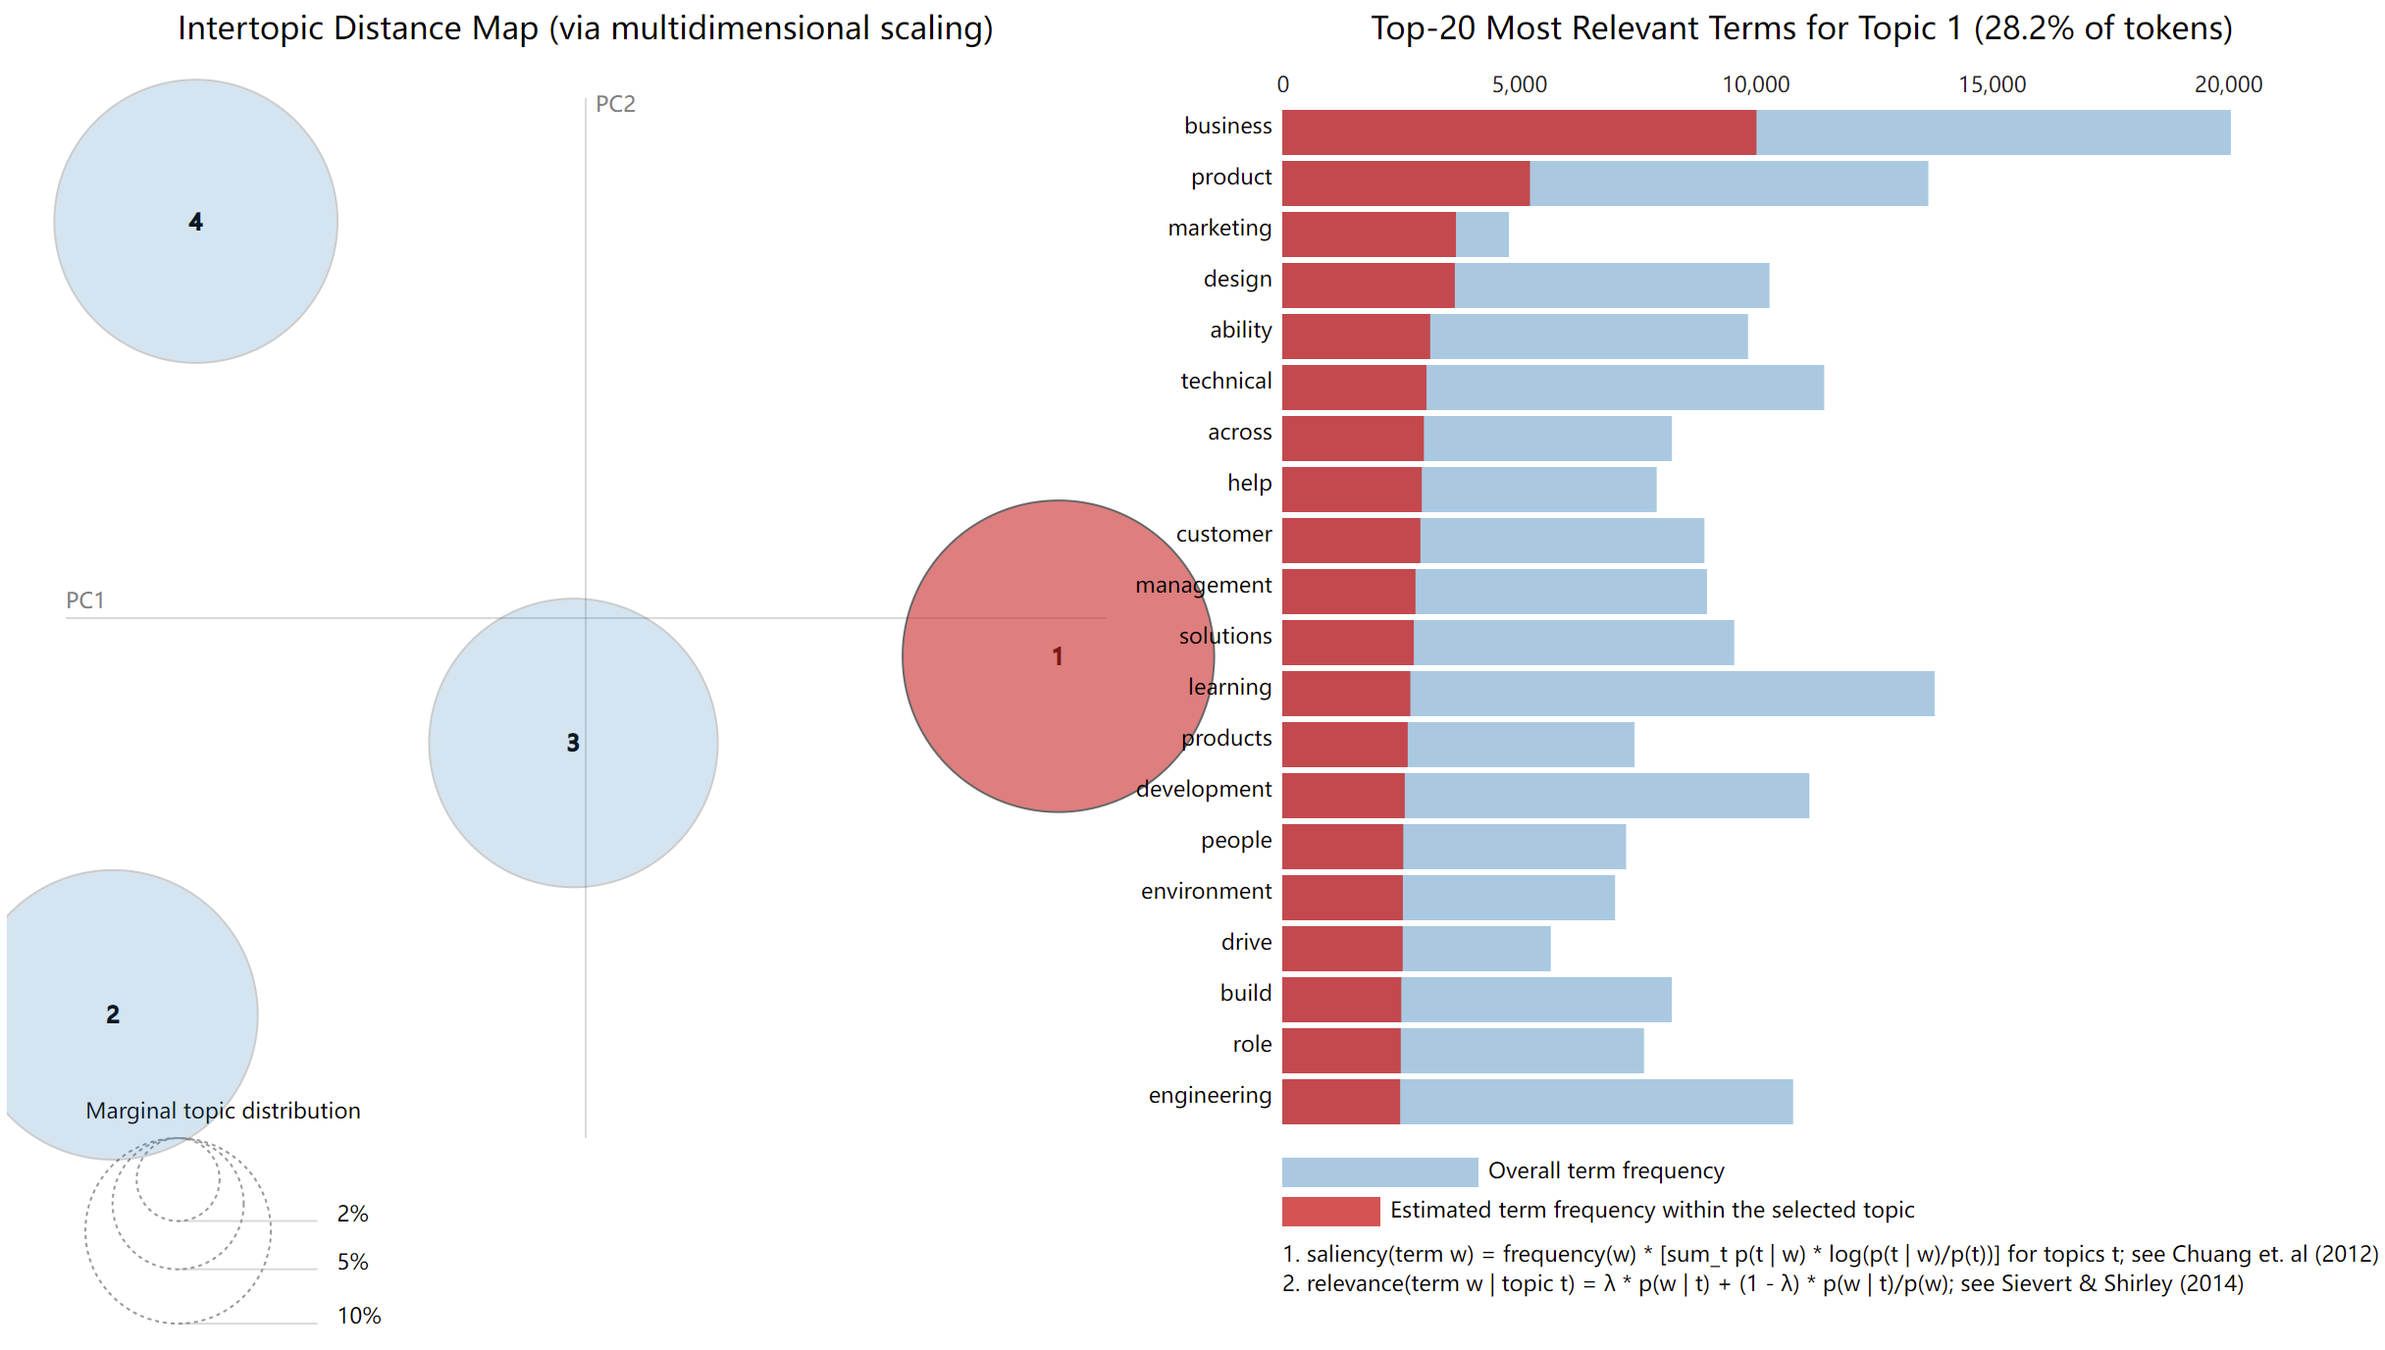
Topic Analysis
Inter-topic distance map by gensim and pyLDAvis

Slide 26
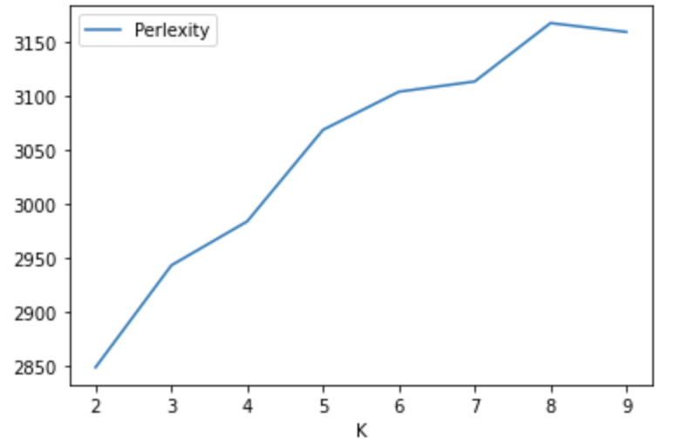
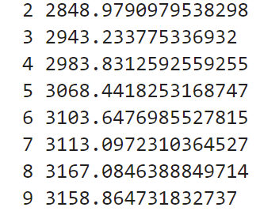
Topic Analysis
Best numbers of topics
Calculate perplexity for each number(2-9) of topics:

Slide 27
05
Model

Slide 28
Goal
Build a model to predict whether the salary will be higher than the average.
SVM
XGBoost
LightGBM

Slide 29
Date Set
Feature:
City: N × 3
The shape of feature: N × 88
Job type: N × 5
TF-IDF of Job Title: N × 60
Degree: N × 3
Tools and Skills: N × 10​
Senior or Junior: N × 2
Label:​
0: if the salary is lower than the average.​
1: otherwise​
The shape of label: N × 1​
​

Slide 30
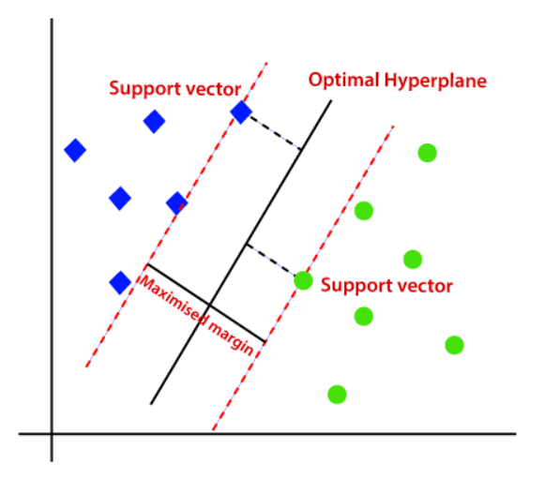
SVM
Find the hyperplane that makes the biggest gap or margin between the two classes

Slide 31
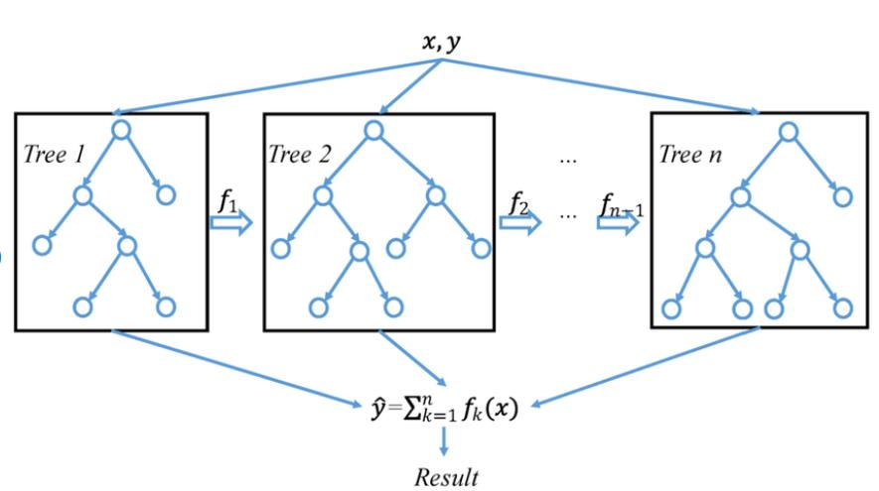
Boosting model
Trees are added one at a time to the ensemble and fit to correct the prediction errors made by prior models.

Slide 32
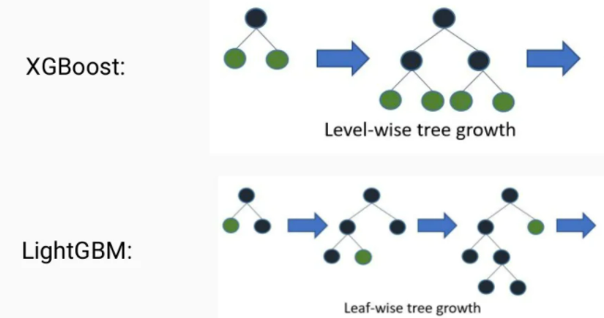
XGBoost and LightGBM
LightGBM is faster than XGBoost, and it can get similar performance

Slide 33
Result
Model | Accuracy
SVM | Train | 0.881
 | Test | 0.876
LightGBM | Train | 0.938
 | Test | 0.904
XGBoost | Train | 0.963
 | Test | 0.931

Slide 34
06
Future Work

Slide 35
Future work
What are the limitations and how to improve?
How to extract the feature of job title more effectively
How to extract useful information from context text more accurately

Slide 36
Thanks and Questions?

